Slide 1
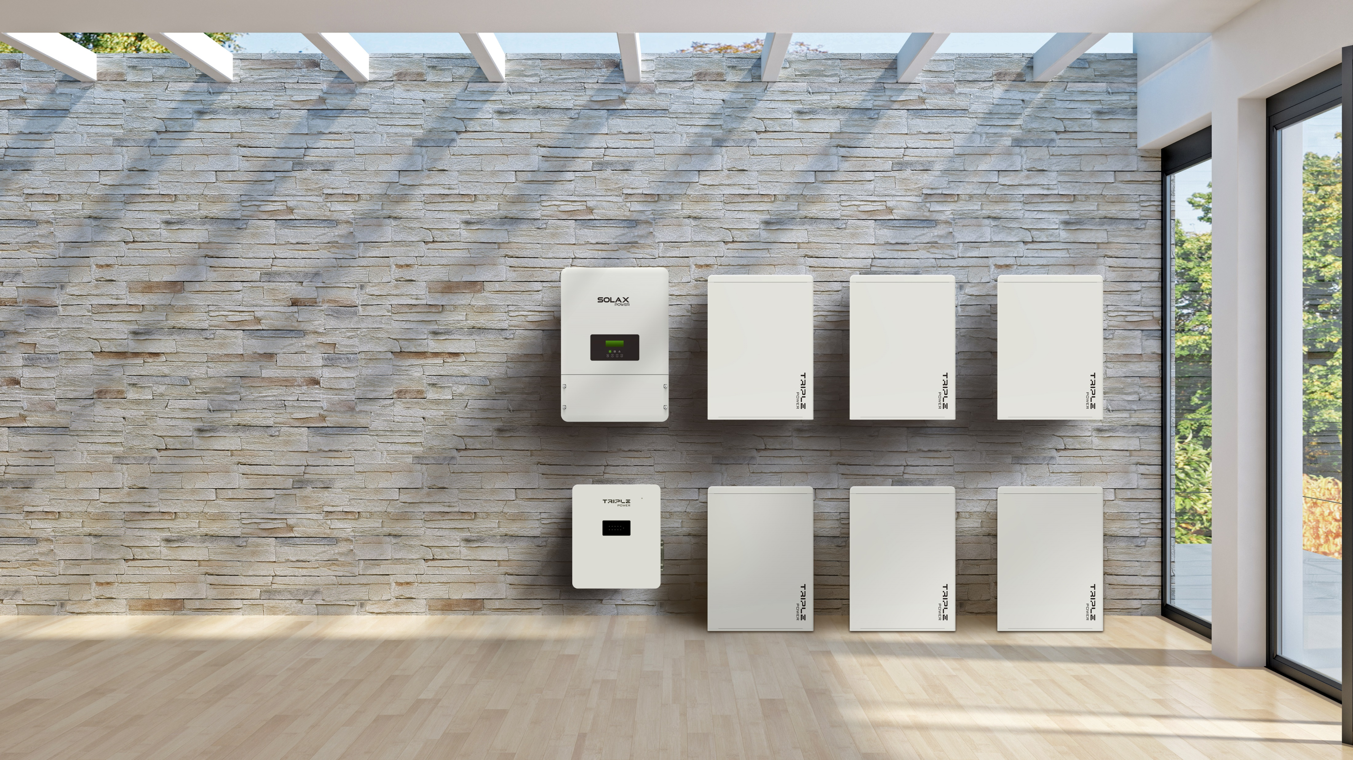


Solax
BMS-Parallel Box
Phrasios

Slide 2

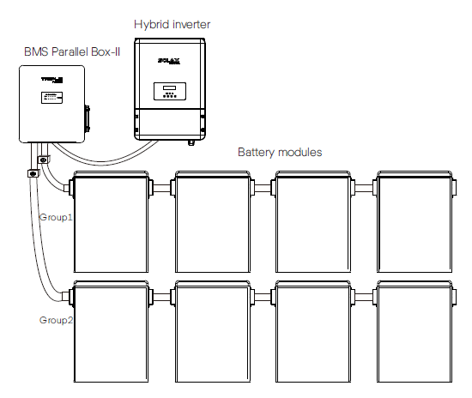
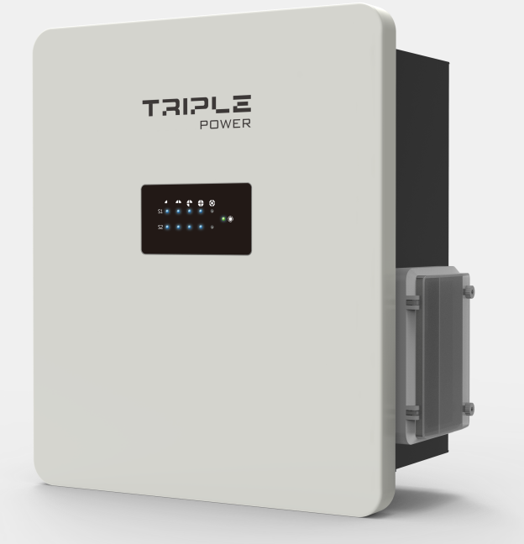



01
Model Introduction

Slide 3
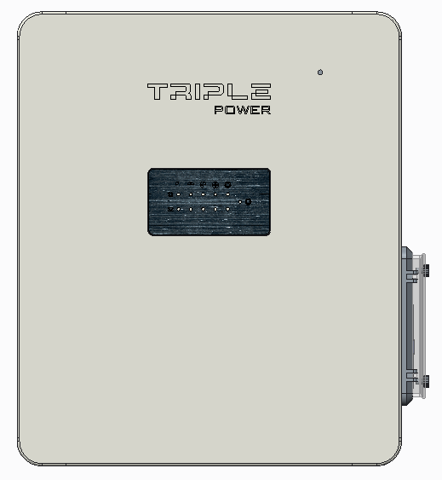
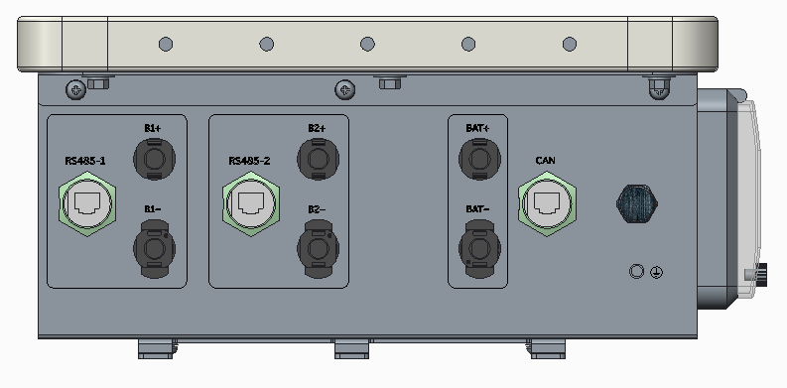
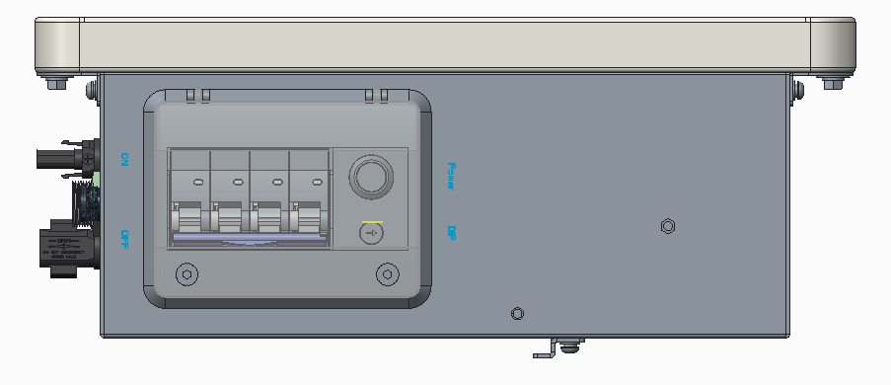
BMS Parallel Box-II
02
Model Introduction-BMS
System Information(BMS Parallel Box-II)
Operating Voltage | : | 70V-550 V
Max. Current | : | 35 A
Weight | : | 5.2kg
Dimensions | : | 368mm * 334mm * 144mm
Ingress Protection | ： | IP55
Operating Temperature | ： | 0℃-55℃
Cooling Type | : | natural cooling

Slide 4
03
Products Comparison
Traditional BMS
BMS Parallel Box-II
(1) The upper limit of capacity is 18 to 25.2kW;
(2) The BMS must be placed at the top of the battery packs;
(3) The BMS cannot be installed on the wall independently;
(4) The BMS is designed consistently with the battery style.
(5) No N+1 backup protection
(1) The capacity of the system is expended to 46.4kW;
(2) The BMS doesn’t need to be placed on the battery packs anymore;
(3) The BMS can be hung on the wall independently;
(4) The BMS is designed consistently with the inverter style.
(5) N+1 backup protection.

Slide 5
04
Critical Parameters

Slide 6
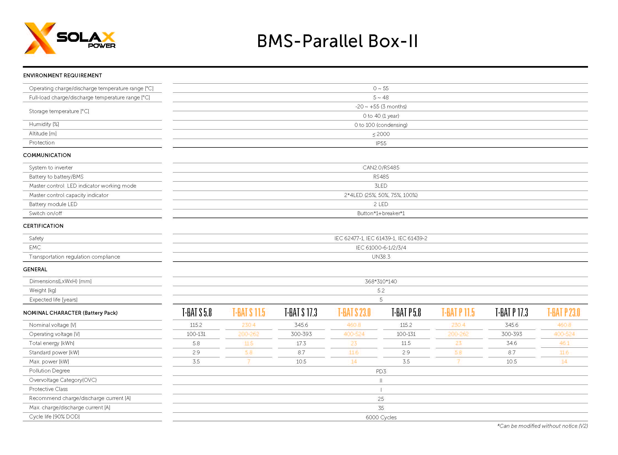

05
System Parameters

Slide 7
06
Selling Points
(1) The battery capacity can be doubled
The conventional battery system is limited by the system voltage and the volume of a single cell, with a set of 4 cells, and the capacity is between 12 and 25KW. The main control is a single bus and cannot be expanded in parallel;
The BMS-Parallel Box is designed with dual-bus dual-circuit power supply, which can double the number of existing battery cells. For example, the capacity of T58*4 (23KW) can be expanded to T58*8 (46KW);
(2) With dual-module backup capability
The BMS-Parallel Box has dual bus bars inside, and the control board has dual power supply design, which can be reliably separated when one of the battery systems fails without affecting the normal operation of the other group, which can effectively protect the important load. Power supply safety;
(3) Extend battery life
The two groups of battery modules in the parallel main control can be used alternately, which can greatly reduce the cycle rate of a single battery and extend the use time of the battery system;

Slide 8
06
Selling Points
(4) It is convenient for customers to expand and install
The BMS-Parallel Box can be mounted on the wall, which can reduce the disassembly and installation of the originally installed battery system when the user expands the capacity.
(5) Support mixed use of new and old modules
Ensure that the new and old modules are connected in series and then installed and used in the parallel box. The system can automatically identify the new and old battery packs and enable them to be charged and discharged independently.
(6) More convenient maintenance
The battery can be upgraded remotely, remotely monitor data and real-time alarm, quickly discover and maintain products; connect to the inverter, support local U disk upgrade.

Slide 9
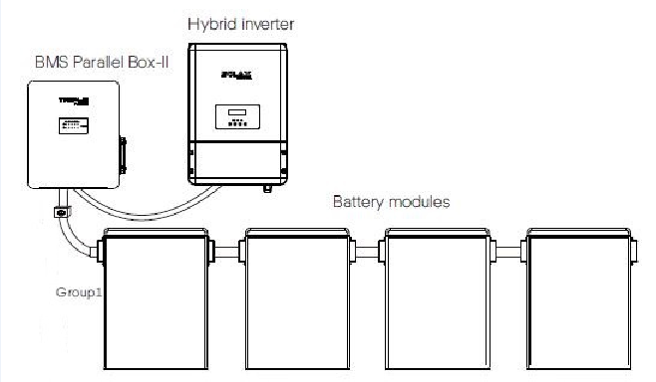
07
Solutions

Slide 10
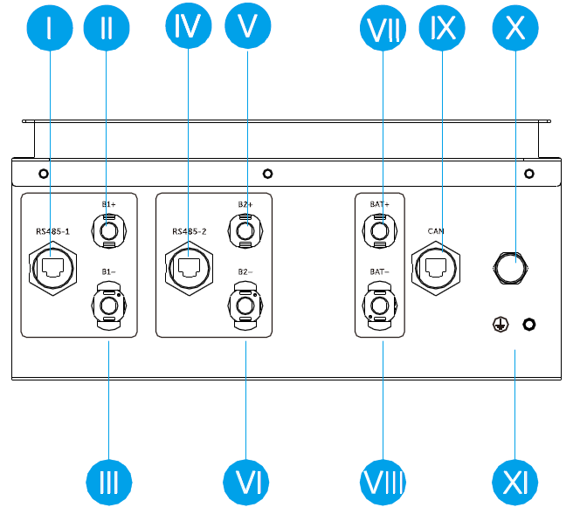
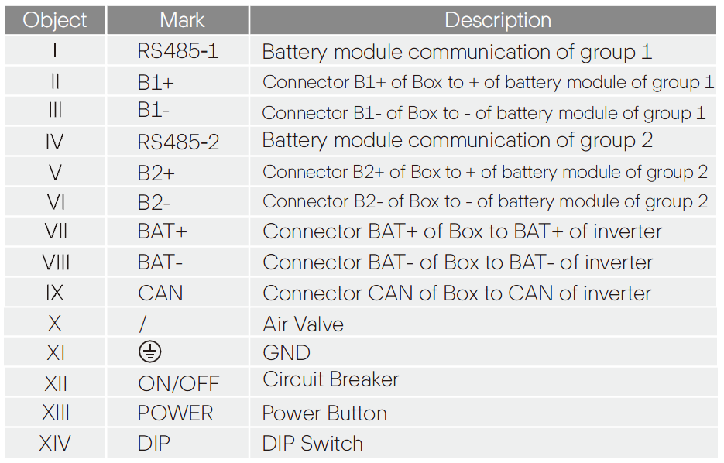
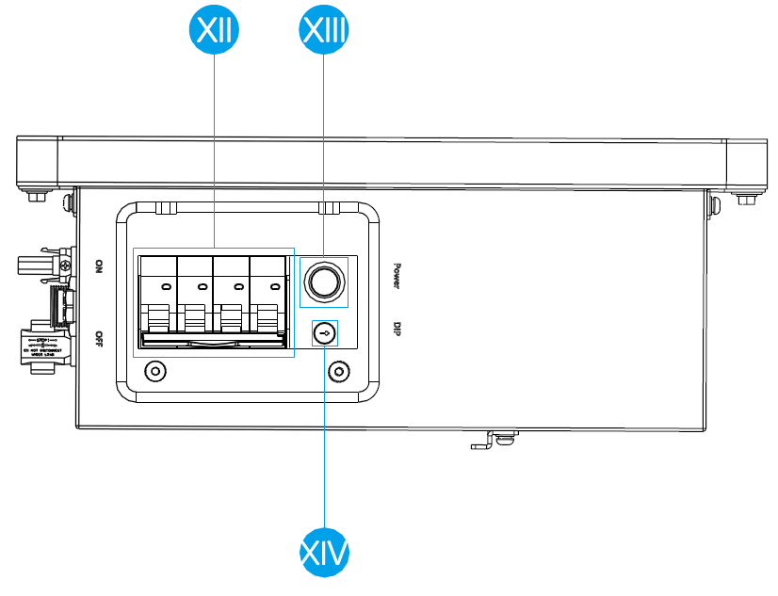
08
Terminals Illustration

Slide 11
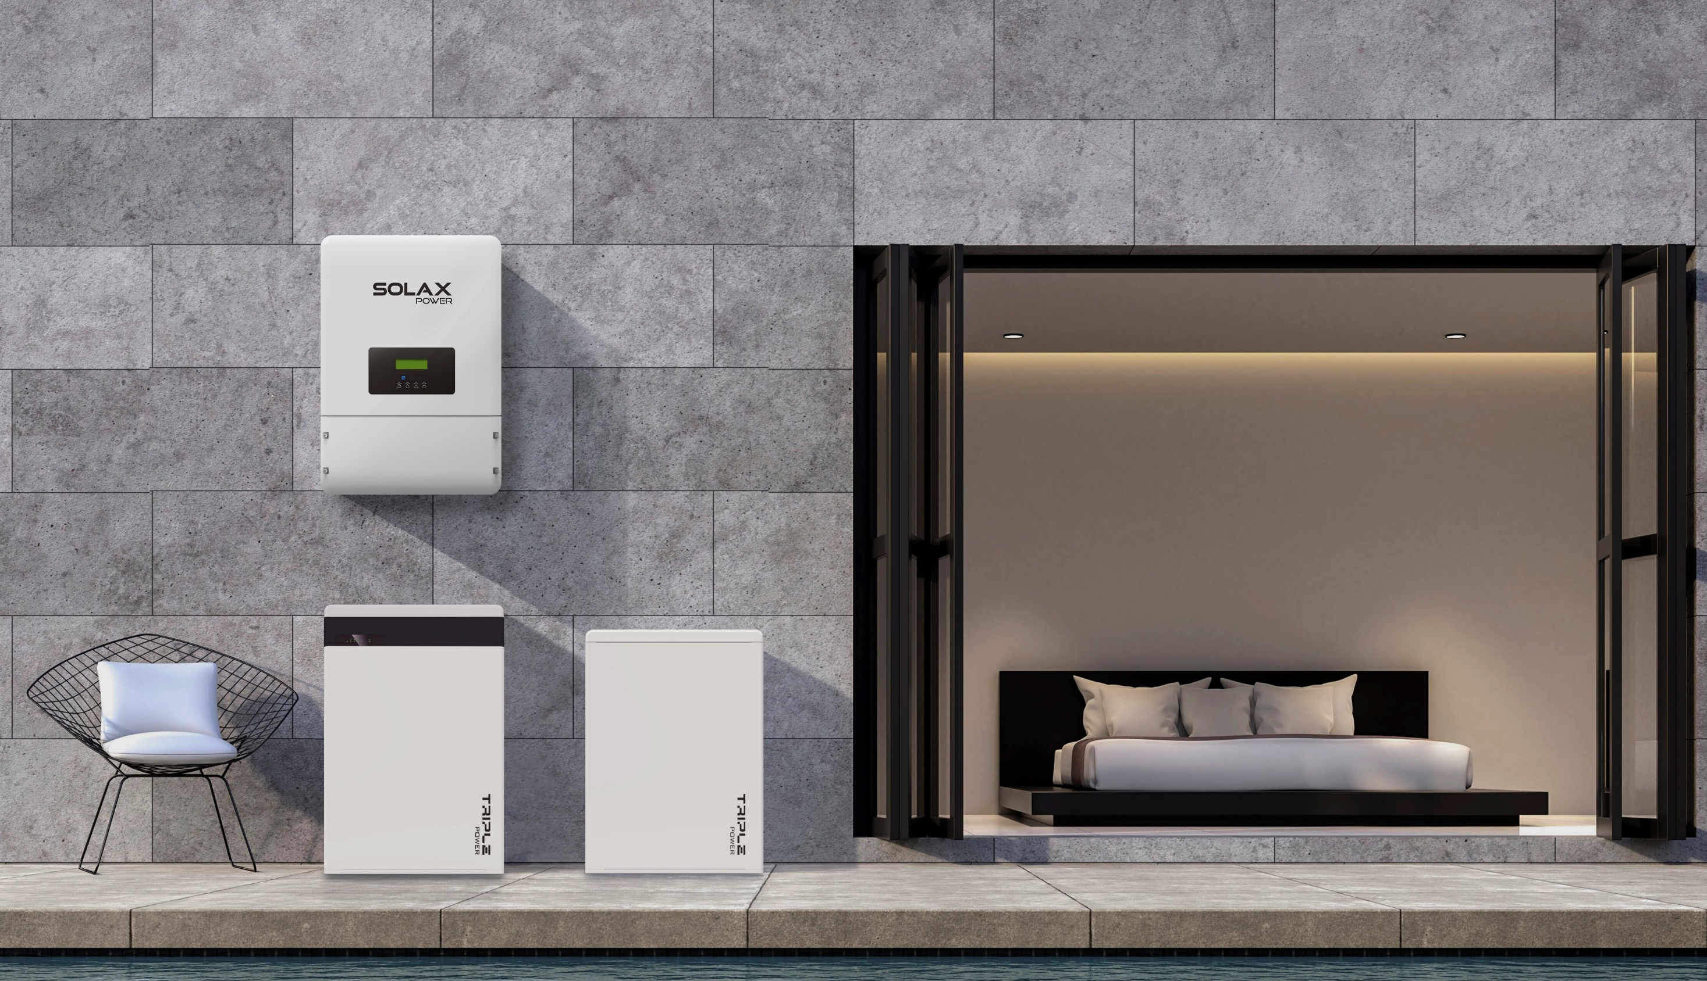
THANK YOU
www.solaxpower.com info@solaxpower.com

